Slide 1



Advanced Network Tap application for
Flight Test Instrumentation Systems
Øyvind Holmeide/Markus Schmitz
by
10/26/2015

Slide 2
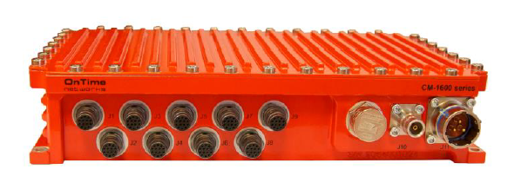
Network taps
Why network tap?
Relevant when the operational network and mission network, (e.g. FTI) are two different networks
Mission network shall not interfere with the operational network
No need to duplicating/installing a specific FTI data acquisition system to receive this data

Slide 3
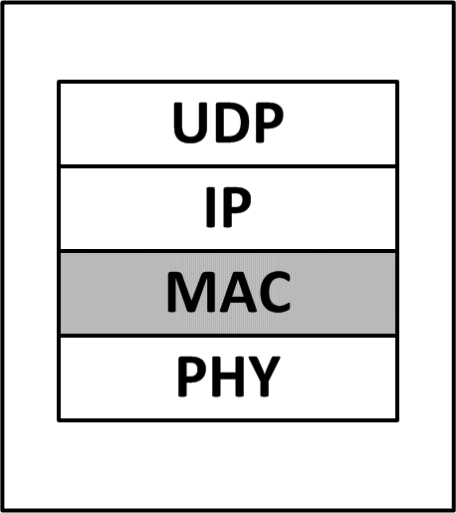
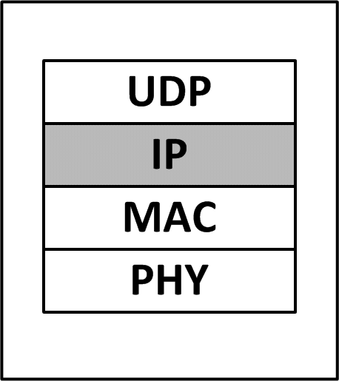
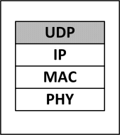
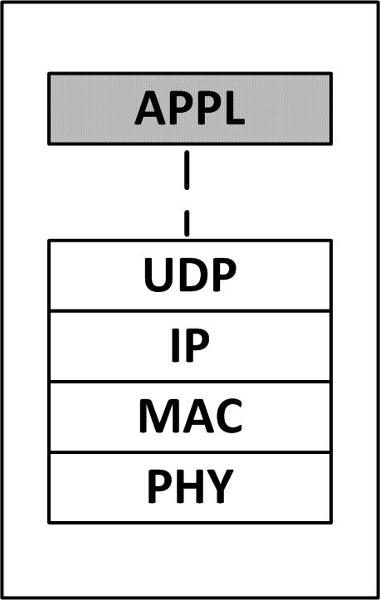

Filtering
Tap filtering packets based on:
  Layer 2, MAC/VLAN
  Layer 3, IP addresses (source or destination)
  Layer 4, UDP port numbers
  Layer 7, Payload parameter.

Slide 4
Ethernet Network Taps
Two types of Ethernet Network Taps:
End Point Tap
Inline Tap

Slide 5
End point Tap
Operational Network
Operational
Network switch
Network element 1
Network element 2
Network element 3
CM1600
used as tap
Monitoring device 1
Monitoring device 2
End point Tap
Monitoring device 3

Slide 6
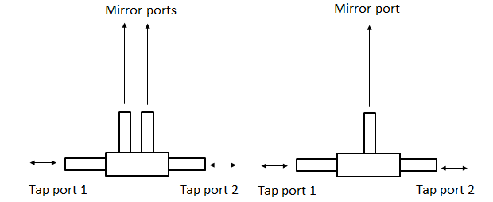
Inline Tap
Network Tap is part of the operational network
One or two mirror ports
Two mirror ports means:
  No packet loss
  Minimal latency through the tap

Slide 7
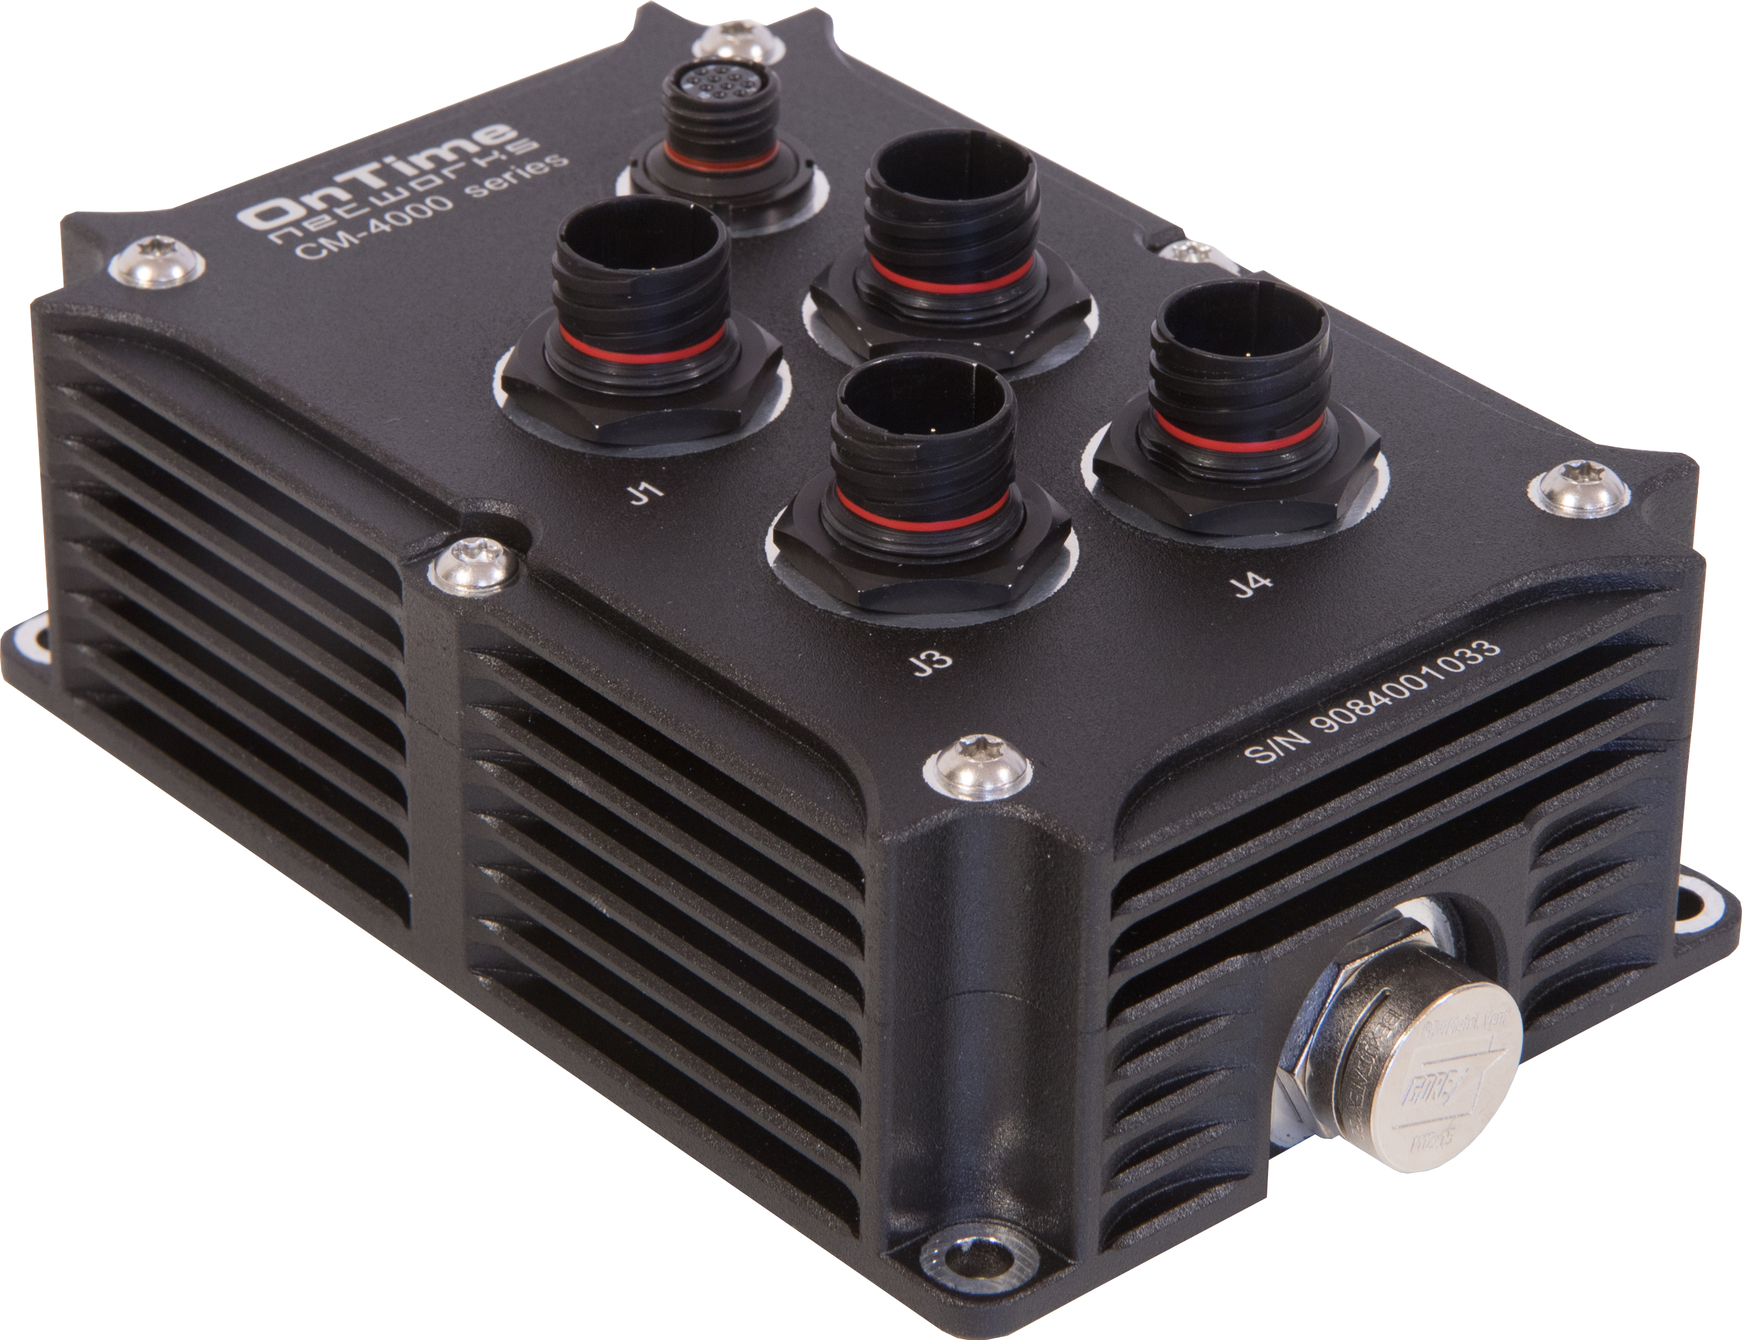
Inline Tap
How to monitor the traffic sent to/from an End node?
TAP Function
End node
Switch
Solution:
The inline Tap is used to tap the Ethernet traffic sent to/from an end node and forwarded to a monitoring unit. The traffic sent to the monitoring unit can also
be filtered
Monitoring device or recorder

Slide 8
Port Mirroring vs Network Tap
Why not use a standard operational switch with port mirroring as an Inline Tap?
Not a good idea, because:
Switch packet scheduler grants the Switch Port Mirroring function lowest possible priority
Switch Port Mirroring will be disabled in case of congestion with packet loss on the monitoring port as a result.
Switch Port Mirroring might require switch resources that can load the switch and lead to reduced switching performance.

Slide 9
Latency Aspects of Inline Taps
An Inline Tap will increase the network latency, but:
  network tap latency in TAP mode, will not depend on the network load on the Inline Tap.
  The Inline Tap latency depends on the port speed, packet length and a general static latency of a few microseconds.
  The network tap latency in case the Inline Tap is running in BYPASS mode, is close to zero.
Full egress bandwidth of tap port 1 is allocated to the ingress data received on the tap port 2 and vice versa:
  Therefore not latency jitter introduced due to packet queueing

Slide 10
Safety
No Traffic flow back into the operational network, as
  The mirror ports of the Inline Tap can receive data, but this data can only be sent to the CPU of the Inline Tap.
  Therefore, data from the FTI system cannot flow back into the ONS system.

Slide 11
Time Stamping of Mirrored Data
Implementation of IEEE1588 PTP Slave Clock or a NTP/SNTP client to use for time stamp generation at the tap level
Time Stamping of Mirrored Data critical if tapped data is not directly sent to a recorder
Tapped data should be time stamped as close to the source as possible
Time stamp inserted by time stamp module, either in packet header or in packet payload.
Preferably, and before being inserted into the packet, the time stamp generated for a particular packet is adjusted for the propagation delay between the sending node and the network tap element.

Slide 12


Advanced Inline Tap Applications
Patent
pending
Packet filtering based on e.g. VLAN id
Bypass function to/from tap port 1 and tap port 2,
where Bypass mode is entered if tap is:
  Without power
  Malfunction detected or BIT failed
Time stamping of mirrored packets where
the time stamps are inserted into the packets

Slide 13
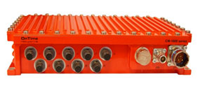

Advanced Inline Tap + End Point Tap
Patent
pending
Inline Tap forward mirrored data to the End Point Tap
End Point Tap filters the data with different filtering rules for the monitoring ports

Slide 14
Conclusion
Advanced Inline Network Tap, supports:
  No packet loss if separate ports are used for uplink and downlink
  Static latency
  BYPASS and TAP mode; i.e. Tap can be part of operational network
  Packet filtering
  Time stamping of mirrored packets

Slide 15
Questions?

