Slide 1


ETTC 2015-Guaranteed end-to-end latency through Ethernet
Øyvind Holmeide
by
02/01/2015

Slide 2
FTI network challenges
This presentation targets the following Flight Test Instrumentation (FTI) network challenge:
How to guarantee worst-case latency for latency sensitive data?
  Answer: Quality of Service (QoS)

Slide 3
Quality of Service (QoS)
Quality of Service (QoS) in Ethernet
QoS is relevant for:
  Real time critical data
  Latency sensitive data
  Loss critical data
QoS can be configured on Ethernet switches based on:
  Layer 1: Port based priority
  Layer 2: VLAN tagging (IEEE802.1p)
  Layer 3: IP ToS/CoS

Slide 4
Quality of Service (QoS)
Standard Ethernet switches provide several QoS properties:
Scalable bandwidth
Full duplex connectivity (no collision)
Flow control off – deterministic access (send when you want)
Several queues per port:
  High priority packets in high queues
  Low priority packets in low queues
Strict/fixed priority scheduling (QoS policy) gives best QoS properties for high priority data

Slide 5
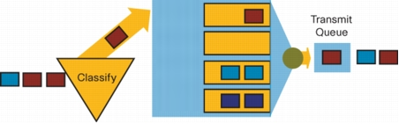
Quality of Service (QoS)
QoS: Traffic prioritization:

Slide 6
Quality of Service (QoS)
Layer 1 – Priority classification based on: Port priority:
All incoming packets will be given the same priority
The associated packet priority is lost for the next switch in the network chain, unless:
A VLAN tag including the packet priority is kept on the switch egress port
7. Application
6. Presentation
5. Session
4. Transport
3. Network
2. Data link
1. Physical

Slide 7
Quality of Service (QoS)
Layer 2 - Priority classification based on: IEEE802.1p
Ethernet layer MAC header (layer 2) without 802.1p
Destination
Source
type
FCS
Ethernet MAC header (layer 2) with 802.1p
Destination
Source
tag
type
FCS
7. Application
0x8100
XXX
X
0xXXXX
6. Presentation
5. Session
12-bit 802.1Q VLAN Identifier
4. Transport
Canonical - 1 bit
3. Network
Tagged frame Type Interpretation 3-bit Priority Field (802.1p)
2. Data link
Tagged frame Type Interpretation - 16 bit
1. Physical

Slide 8
Quality of Service (QoS)
Layer 3 - Priority classification based on: IP ToS/CoS
IPv4 header (layer 3)
MAC
IP
Version
IHL
Type of service
Total lenght
Identification
D
M
Fragment offset
F
F
Time to live
Header checksum
7. Application
6. Presentation
Source IP address
Source address
5. Session
4. Transport
Destination IP address
3. Network
2. Data link
Options
1. Physical

Slide 9
Quality of Service (QoS)
How to guarantee worst-case latency for latency sensitive data?
High priority packets = latency sensitive data
Such data will never be lost in the switch due to congestion and the worst case latency for such packets can be calculated if:
  The total amount of high priority traffic never exceeds the bandwidth of the drop links
  Worst case latency for high priority packets can be calculated if the characteristics of the high priority packets are known
Example ...

Slide 10
Quality of Service (QoS)
Example:
100 Mbps with full duplex connectivity is used on all data source drop links and 1Gps is used on switch trunk ports
The switch is a store-and-forward switch with a minimum switch latency of 10μs.
The switch uses strict priority scheduling
The latency sensitive packet has a length of 200 bytes including preamble, MAC, IP, UDP, payload, FCS and minimum IPG. The latency sensitive packets are treated as high priority packets; all other packets have less priority
Up to five other end nodes may generate similar latency sensitive packets of 200 bytes that may be in the same priority queue before the packet enters the queue, and causes extra switch delay
All latency sensitive packets are generated in a cyclic manner
Cont’d ..

Slide 11
Quality of Service (QoS)
Example cont’d:
The worst case switch latency of a latency sensitive packet will then be:
  16μs, store-and-forward delay.
  10μs, minimum switch latency.
  12μs, worst-case latency due to flushing of a packet with maximum packet length.
  8μs, five latency sensitive packets already in the same priority queue.
  46μs, worst case - total

Slide 12
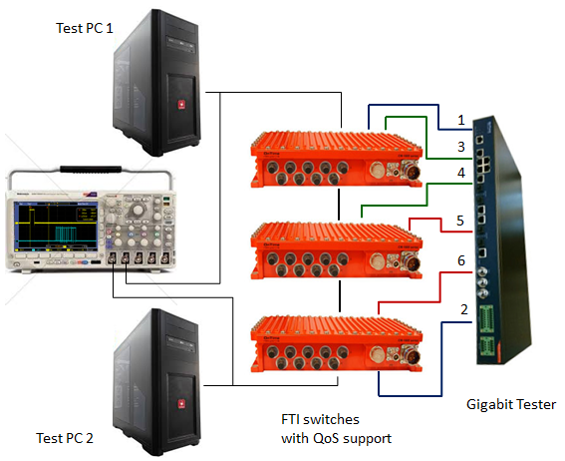
Quality of Service (QoS)
Measurement setup:

Slide 13
Quality of Service (QoS)
Measurement setup cont’d:
The data streams are sent to/from the tester according to the following setup:
data stream 1 (blue) is sent from port 1 to port 2 on the tester through all three FTI switches (downlink)
data stream 2 (blue) is sent from port 2 to port 1 on the tester through all three FTI switches (uplink)
data stream 3 (green) is sent from port 3 to port 4 on the tester through the two top most FTI switches (downlink)
data stream 4 (green) is sent from port 4 to port 3 on the tester through the two top most FTI switches (uplink)
data stream 5 (red) is sent from port 5 to port 6 on the tester through the two lower FTI switches (downlink)
data stream 6 (red) is sent from port 6 to port 7 on the tester through the two lower FTI switches (downlink)

Slide 14
Quality of Service (QoS)
Measurement setup cont’d :
Each test stream consist of test packets of 1450 bytes 100ns inter-packet gap with infinite duration; i.e. 100% overload.
Packet queues for ports connected to another switch are always full!
All tester ports = 1000BASE-T(x)
All switch to switch ports = 1000BASE-T(x)
PC 1 and 2 = 100BASE-T(x)
The transmit time of the latency sensitive data is measured at PHY level on PC 1 on the setup and the corresponding receive time of the same data is measured at PHY level on PC 2
Latency sensitive data is sent from PC1 to PC2 through a client/server UDP socket application, where the socket is configured for high priority. I.e. the sending end node (PC1) configures the socket with the setsockopt( ) command with TOS field set to e.g. 0xF8.

Slide 15
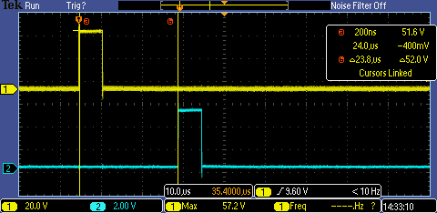
Quality of Service (QoS)
Measurement result, no tester load:

Slide 16
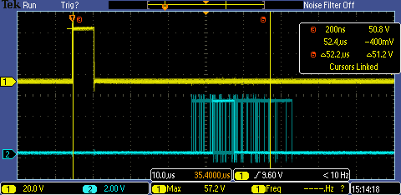
Quality of Service (QoS)
Measurement result, tester load:

Slide 17
Conclusion
Worst case switch latency for latency sensitive data through an FTI network consisting of several network hops can be guaranteed. The latency for such data can be far less than 200μs if:
  The total amount of latency sensitive data only represents a small fraction of the total network load
  Latency sensitive data is identified by the FTI switches as high priority data and all other data has less priority
  Gigabit speed is used in the FTI back bone
  Strict priority scheduling is used on the FTI switches

