Slide 1



PTP version 3 in FTI?
Øyvind Holmeide/Markus Schmitz
by
01/13/2016

Slide 2
PTP in FTI
Overview:
PTP version 3 in FTI?
Proposal for a PTP profile for FTI

Slide 3
PTP version 3 for FTI?
The scope of the PTP version 3 working group:
- Correct known technical and editorial errors
- Better accuracy
- Definition of an SNMP MIB
- Security
- Clarify the layering, interfaces and protocol of the standard

Slide 4
PTP version 3 for FTI?
Don’t panic!
The new revision of the IEEE 1588™ standard will be backward compatible with version 2
and all new functions will be optional

Slide 5
PTP version 3 for FTI?
IEEE 1588™ has established five sub-committees:
Architecture
High Accuracy
Upkeep
Management
Security

Slide 6
PTP version 3 for FTI?
Architecture sub-committee
Topic | Description | Relevance for FTI
State reduction | FAULTY, PRE-MASTER and UNCALIBARTED states would become optional | NA, this is implementation specific requirement
Profile isolation | A transport specific attribute in the PTP header is used to isolate multiple PTP profiles in the same network | NA, only one PTP profile should be used in a FTI network
Port State Configuration | A PTP port can be BMCA capable, SC only or GMC/MC only, where manual configuration is possible | NA, all GMC candidates should support BMCA
PTP domains | Multiple PTP domains in a network can share the same timing data | NA, FTI should only allow one PTP domain (default domain)

Slide 7
PTP version 3 for FTI?
High Accuracy sub-committee
Topic | Description | Relevance for FTI
Synchronization better than 1 nanosecond | Includes support for SyncE Frequency synchronization may be achieved through a different spanning tree than the spanning tree used for PTP Calibration of each SC including compensation for all asymmetric components and cable delays will be part of the proposal A “Golden Calibrator” for a given system may be required. | Data acquisition with sub-nanosecond or single digit nanoseconds accuracy in some future FTI systems may be relevant

Slide 8
PTP version 3 for FTI?
Upkeep sub-committee
Topic | Description | Relevance for FTI
Upkeep | Incorporate official IEEE interpretations and other known errors or needed clarification into 1588-2008 including clarification on the clarification of the TC source address topic Serve as a “quality control” function for any modifications proposed | NA, no major impact from the Upkeep section is expected for FTI

Slide 9
PTP version 3 for FTI?
Management sub-committee
Topic | Description | Relevance for FTI
Management protocols | Create a single IEEE 1588 MIB for SNMP management Other management protocols | A standard MIB can be considered for FTI

Slide 10
PTP version 3 for FTI?
Security sub-committee
Topic | Description | Relevance for FTI
Security capability | Technologies such as IPSec and MACSec are considered Requirements are based on IETF document: “draft-ietf-tictoc-security-requirements | NA, security related to PTP synchronization has not been an issue for FTI up to now

Slide 11
PTP profile for FTI
Main PTP properties that are relevant for a PTP profile for FTI:
PTP versions
Clock modes
One-step vs. two step clocks
Media
Delay mechanism
Transport mechanism
Domain
Selection of Best Master Clock
PTP EPOCH
Sync interval
Delay_Req interval
Announce interval
PPS output
IRIG-B 002/122
Management
SNMP traps
GMC holdover
SC accuracy
SC time to synchronization

Slide 12
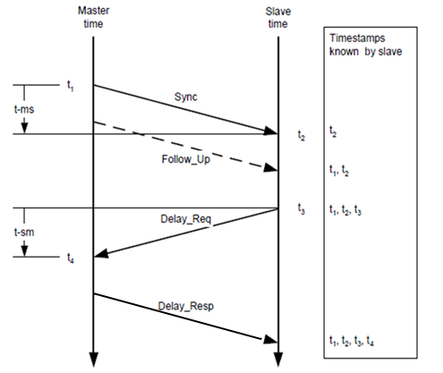
PTP profile for FTI
PTP versions
  Version 1 according to IEEE 1588™ - 2002
  Version 2 according to IEEE 1588™ - 2008
  Version 3: NA, except for systems with sub-nanosecond requirements
Clock modes
  Grand Master Clock (GMC)
  Ordinary Clock (OC)
  (Boundary Clock (BC))
  Transparent Clock (TC)
  Slave Clock (SC) only
One-step vs. two step clocks
  Only two-step

Slide 13
PTP profile for FTI
Media
  Ethernet
  10/100BASE-T(X), 100BASE-FX, ), 1000BASE-X and 10GBASE-X, etc
  Full Duplex
Delay mechanism
  E2E
Transport mechanism
  PTP over UDP/IP
  Multicast with destination IP address: 224.0.1.129
  UDP destination port number 319 (event packets)
  and 320 (general packets)

Slide 14
PTP profile for FTI
Domain
  Default domain (0)
Selection of Best Master Clock
  Default BMCA (mandatory)
PTP EPOCH
  TAI

Slide 15
PTP profile for FTI
Sync interval
  [1, 2] seconds for IEEE 1588™ - 2002, where:
  1 second is default Sync interval for IEEE 1588™ - 2002
  [0.125 .. 2] seconds for IEEE 1588™ - 2008, where:
  0.125ms is default Sync interval for IEEE 1588™ - 2008
Delay_Req interval
  60 seconds with randomization for IEEE 1588™ - 2002
  [Sync interval, 32 x Sync_interval] seconds with randomization for
  IEEE 1588™ - 2008
Announce interval
  1588™ - 2002: NA
  1588™ - 2008: 2 x Sync interval

Slide 16
PTP profile for FTI
PPS output
  Mandatory for;
    GMC
    OC
    (BC)
    TC/SC
    SC
IRIG-B 002/122
  Mandatory for;
    GMC
    OC
  Optional for;
    TC/SC
    SC

Slide 17
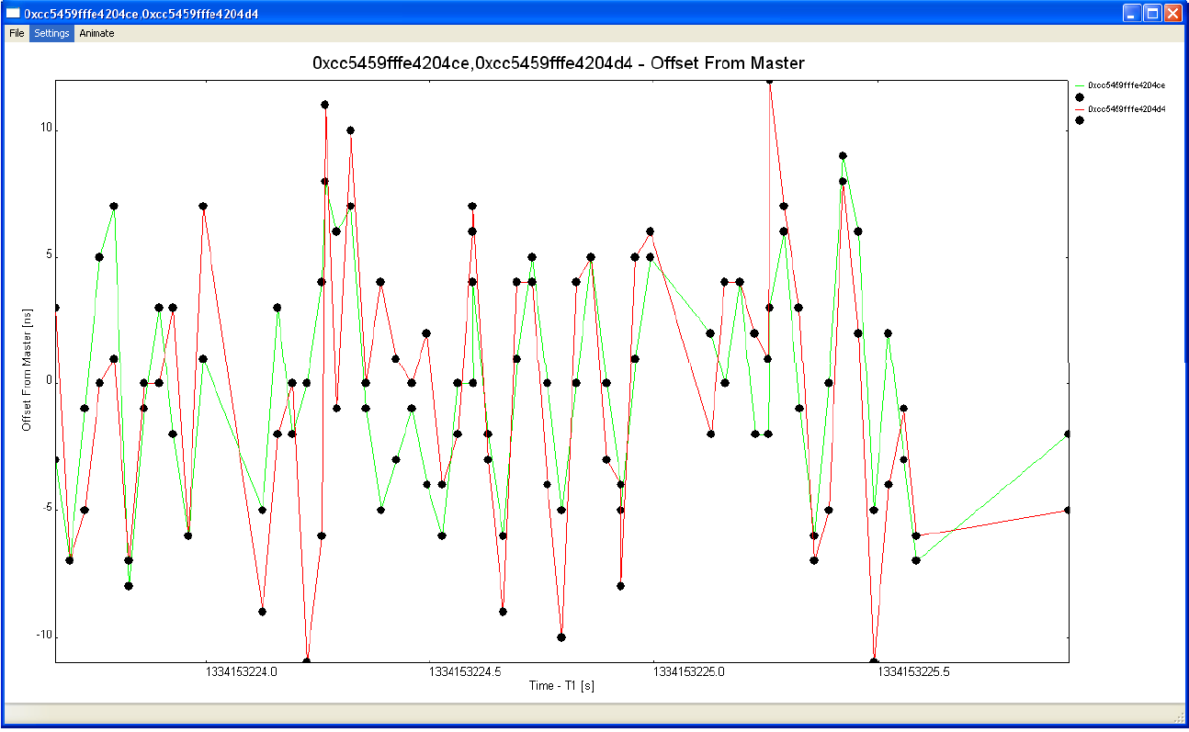
PTP profile for FTI
Management
  Mandatory:
    iNET SNMP and MDL
  Optional:
    PTP management according to chapter 15 of IEEE 1588™ - 2008
    Private MIB or MIB based on PTP version 3?
PTP management
based on
PTPv2Browser,
monitoring
OffsetFromMaster

Slide 18
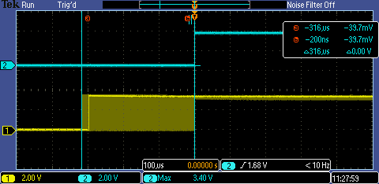
PTP profile for FTI
SNMP traps
  iNET SNMP traps, ref TmNS MIB:
    timeLockLostNotificationBranch
    ieee1588MaxOffsetFromMasterNotificationBranch
    ieee1588MaxJitterNotificationBranch
GMC holdover
  0.1ppm (iNET requirement)
CM1608F0-AERO-GMC, clock drift over 60 minutes with temperature cycling:
-40˚F/-40˚C to 203˚F/95˚C

Slide 19
PTP profile for FTI
SC accuracy
  1ppm (iNET requirement)
SC time to synchronization
  1 seconds for airborne systems (iNET requirement)
  3 seconds for ground installations (iNET requirement)

Slide 20
PTP profile for FTI
 | IEEE 1588™ - 2002 FTI PTP profile | IEEE 1588™ - 2008 FTI PTP profile
Clock modes | OC (GMC), TC(*), Slave only | OC (GMC), TC, Slave only
One-step or two step clocks | Two-step | Two-step
Media | Ethernet, full duplex according to IEEE802.3 | Ethernet, full duplex according to IEEE802.3
Delay mechanism | E2E | E2E
Transport mechanism | PTP above UDP/IP, multicast with destination IP address: 224.0.1.129 and UDP destination port number 319 (event packets) and 320 (general packets) | PTP above UDP/IP, multicast with destination IP address: 224.0.1.129 and UDP destination port number 319 (event packets) and 320 (general packets)
Domain | Only default domain (0x00) is used | Only default domain (0x00) is used
Selection of Best Master Clock | Default BMCA algorithm | Default BMCA algorithm
PTP EPOCH | Time representation based in TAI, offset to UTC time (accumulated number of leap seconds) is defined in the currentUTCOffset parameter. | Time representation based in TAI, offset to UTC time (accumulated number of leap seconds) is defined in the currentUTCOffset parameter.
Sync interval | [1, 2]s, default = 1s | [0.125 .. 2]s, default = 0.125s
Delat_req interval | 60s, randomized | [Sync interval .. 32]s, default = 32s, randomized; controlled by GMC
Announce interval | NA | [1, 2, 4, 8, 16]s, default = 2s
PPS output | Mandatory | Mandatory
IRIG-B 002/122 | Mandatory for GMC Optional for TC/SC | Mandatory for GMC Optional for TC/SC
Management | iNET SNMP/MDL | iNET SNMP/MDL Optional: PTP management according to IEEE 1588™ - 2008
SNMP traps | iNET MIB | iNET MIB
GMC holdover | 0.1ppm, iNET requirement | 0.1ppm, iNET requirement
SC accuracy | 1ppm, iNET requirement | 1ppm, iNET requirement
SC time to synchronization | 1s/3s (airborne/ground), iNET requirement | 1s/3s (airborne/ground), iNET requirement

Slide 21

Questions?

