Slide 1


Ethernet Packet Filtering - Part1
Øyvind Holmeide
Jean-Frédéric Gauvin
by
05/06/2014

Slide 2
FTI networks
Challenges in FTI networks:
  Risk for network bottlenecks due to high network load
  High multicast load
  Undesired traffic reaching an end node

Slide 3
OSI model – Packet Filtering by Layer
The OSI (International Organization for Standardization) model groups communication functions into seven logical layers
Packet Filtering can be done on any layer above layer 1 of the OSI model
OSI layers:
Packet Filtering techniques:
7. Application
Packet payload filtering
6. Presentation
5. Session
4. Transport
UDP filtering
3. Network
IP filtering
2. Data link
MAC/VLAN
1. Physical

Slide 4
VLAN – 802.1q protocol
VLAN stands for Virtual Local Area Network
VLAN is used to create logical network separations
Reduce broadcast domains
VLANs allow multiple virtual networks one the same network infrastructure

Slide 5
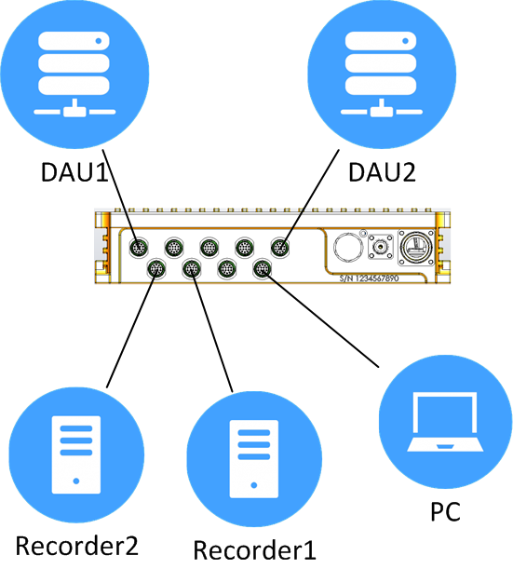
VLAN – 802.1q protocol
Network without VLANs
  Broadcast/multicast/unknown unicast traffic received from one node are forwarded to all other nodes in the network
  The end node must use processor power to discard unwanted traffic

Slide 6
VLAN – 802.1q protocol
Network with VLANs
  Broadcast/multicast/unknown unicast traffic received from one node are forwarded only to the end nodes belonging to the same VLAN
  An end node only receives traffic only from the VLAN that the end node belongs to

Slide 7
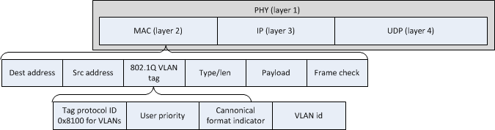
VLAN – IEEE 802.1Q protocol
Dynamic VLAN - how does it work?
  A switch ACCESS port is a port that is connected to an end node and an 1QTRUNK port is a port that is connected to another network element supporting the IEEE 802.1Q protocol
  A VLAN tag is inserted in the Ethernet frame on ingress and removed at egress if the port is an ACCESS port, while the VLAN tag is kept if the port is an IQTRUNK

Slide 8
Dynamic VLAN or GVRP
GVRP stands for Generic VLAN Registration Protocol and is a mechanism used by the network element to learn the VLAN topology via 1QTRUNK ports.
GVRP is used to register and de-register VLAN attributes automatically per port
IEEE 802.1Q aware network nodes exchange VLAN information by sending: join, leave, and leave all messages

Slide 9
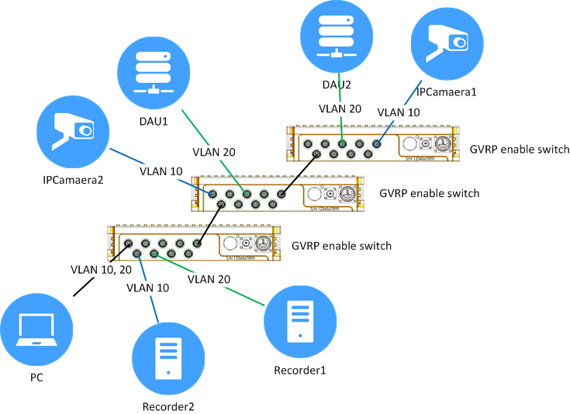
Dynamic VLAN or GVRP
A switch port connected to an end node (an ACCESS ports) need to be assigned a VLAN id.

Slide 10
IP filtering
IP filtering : Multicast filtering
Filtering based on Layer 3 of the OSI model
Extensively used in FTI
Can filter several flow sent from one end node
Static filter or dynamic filter settings
IP multicast IP address range: 224.0.0.1 to 239.255.255.255

Slide 11
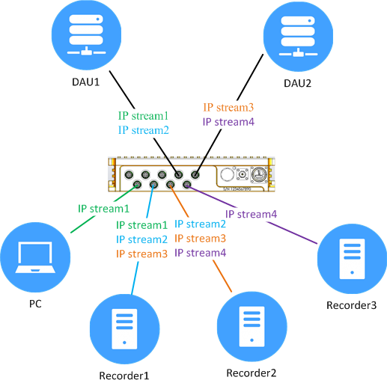
IP filtering
Used to segragate flow and have multiple destination from a single source.
More flexible than VLAN
Filtering based on Protocol Layer (IP layer)

Slide 12
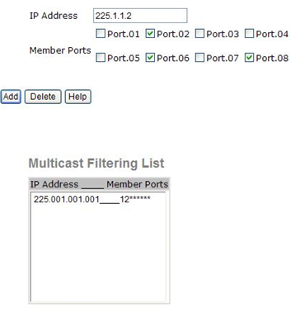
Static IP filtering
The static multicast filter table is configured by the operator
This allows a full overview and a control of the filters used though the network

Slide 13
Dynamic IP filtering - IGMP
IGMP:
Three versions: v1, v2 and v3 (bulk join support)
IGMP packets:
  IGMP queries
  IGMP membership report (IGMP join)
  IGMP leave
snoop the IGMP control packets and set up the corresponding multicast filters
The switch can be set as the IGMP querier (IGMP server) if no router is present.

Slide 14
IP filtering - Static Vs Dynamic
Static Multicast:
  Deterministic
  Configuration on switch level
  Require more network knowledge
IGMP snooping
  Dynamic
  Configuration on consumer level (typ recorder/display)
  Easy to setup

Slide 15
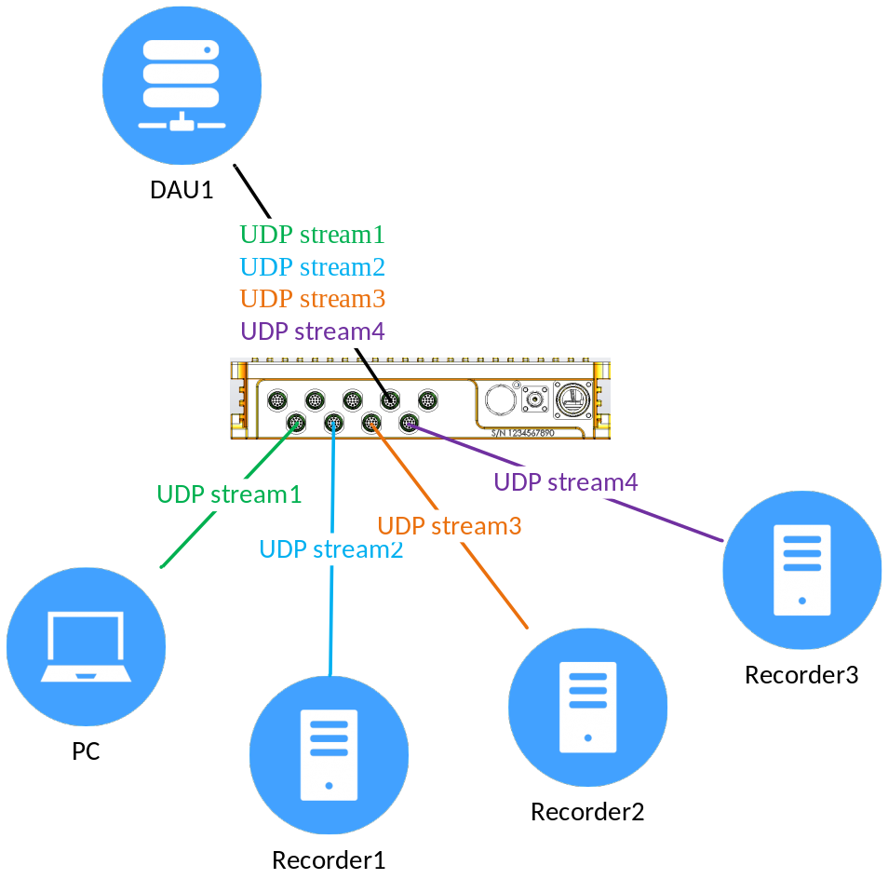
UDP Filtering
Filtering on Layer 4 of the IP model
Use to avoid broadcast filtering on the end node
Filtering based on Source or Destination address

Slide 16
Conclusion
FTI networks are different than telecom networks due to
  Insertion of traffic from an other networks by means of TAP or mirroring
  Simpler architecture
  Broadcast due to software limitation
FTI has needs for more advanced or different way to handle traffic
FTI has the need for custom Ethernet solution in order to fulfill the monitoring requested

